Slide 1

PROJECT REPORT
Basic Inventory and Price Checker (BIPC)
Submission for the Course
Introduction to Problem Solving and Programming
Submitted By:
Ritika Gupta
Registration Number: 25BCE10128
Date of submission-24th Nov
Submitted To:
G Prabu Kanna

Slide 2
Contents
Introduction
Problem Statement
Functional Requirements
Non-functional Requirements
System Architecture
Design Decisions & Rationale
Implementation Details
Screenshots / Results
9 Testing Approach
Challenges Faced
Learnings & Key Takeaways
Future Enhancements
References

Slide 3
Chapter 1
Introduction
The Basic Inventory and Price Checker (BIPC) project was made as a show of core programming concepts, including Object-Oriented Programming (OOP), file persistence, and robust data handling. The primary goal of BIPC is to provide small businesses or departmental stores with a simple (CLI) application for maintaining a centralized, up-to-date catalog of products, their stock levels, and their unit prices. This system replaces error prone manual tracking methods, enhancing the speed and accuracy of price checks and inventory monitoring.

Slide 4
Chapter 2
Problem Statement
Small-scale inventory tracking often relies on decentralized, non-persistent methods such as spreadsheets or physical ledgers. This leads to several issues:
Inaccurate Pricing: Manual updates lead to confusions between recorded prices and actual prices, causing transactional errors.
Poor Stock Visibility: Real time stock levels are unknown, resulting in unexpected stock finish or overstocking.
Lack of Persistence: Data is volatile or easily corrupted.
The BIPC aims to solve this by providing a single, persistent, and verifiable source of truth for all inventory data, ensuring instant and accurate price/stock checks.

Slide 5
Chapter 3
Functional Requirements
The core functionality includes the essential CRUD (Create, Read, Update) operations:
Product Creation: Input new products and automatically generate unique item codes. Inventory Viewing: Display a formatted list of all current products.
Product Update: Modify the price and stock level of existing products by item code. Reporting: Identify and report all products that fall below a pre-defined low stock threshold.
Data Persistence: Load and save inventory data to a local JSON file across sessions
.

Slide 6
Chapter 4
Non-functional Requirements
The system prioritizes quality attributes such as:
Usability: Operable via a simple, menu-driven command-line interface.
Reliability: Must handle corrupted or missing data files gracefully without crashing.
Maintainability: Code is well-organized using functions and classes.
Security (Basic): Includes input validation to prevent unauthorized data types or negative values

Slide 7
Chapter 5
System Architecture
The BIPC uses a simple, three-tiered structure:
1. Data Layer: Local inventory_data.json file for persistence.
2. Business Logic Layer: Python's Product class and core functions
(e.g., generate_item_code ).
3. Presentation Layer: The main menu and I/O handled via the Command-Line Interface (CLI).
Technology Stack: Python 3.x for Core Logic, JSON for Data Persistence

Slide 8
Chapter 6
Design Decisions & Rationale
Key design choices include:
Use of Product Class: Ensures data integrity, encapsulation, and modularity.
JSON for Persistence: Chosen for its simplicity, readability, and native Python support, avoiding the need for a full database.
Auto-Generated Item Codes: Guarantees uniqueness and simplifies product lookup.
Input Validation Loops: Provides robustness by preventing the acceptance of invalid data (non numbers, negative values)

Slide 9
Chapter 8
Implementation Details
The application is implemented in a single Python script. Key details include defining constants for configuration, using the Product.to_dict() method for efficient JSON serialization, and utilizing string formatting to ensure a neatly organized and readable CLI output

Slide 10
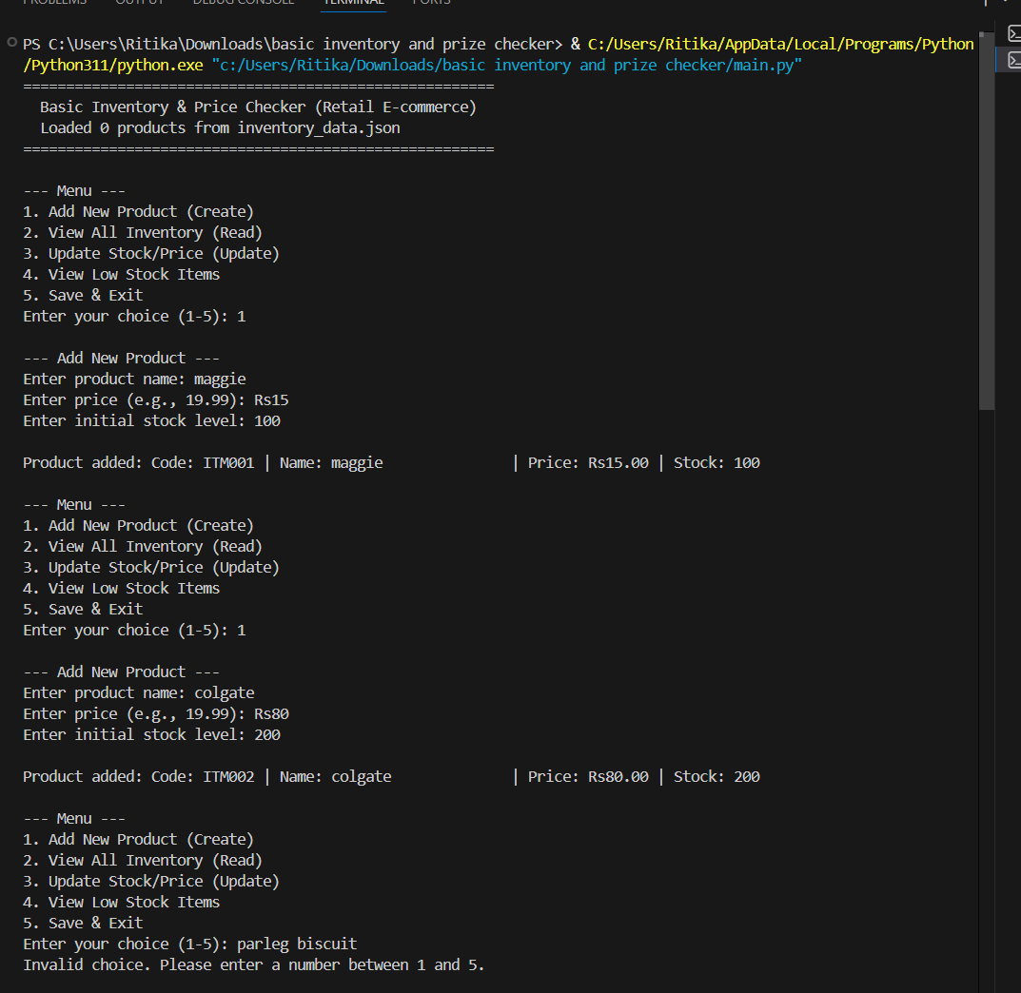
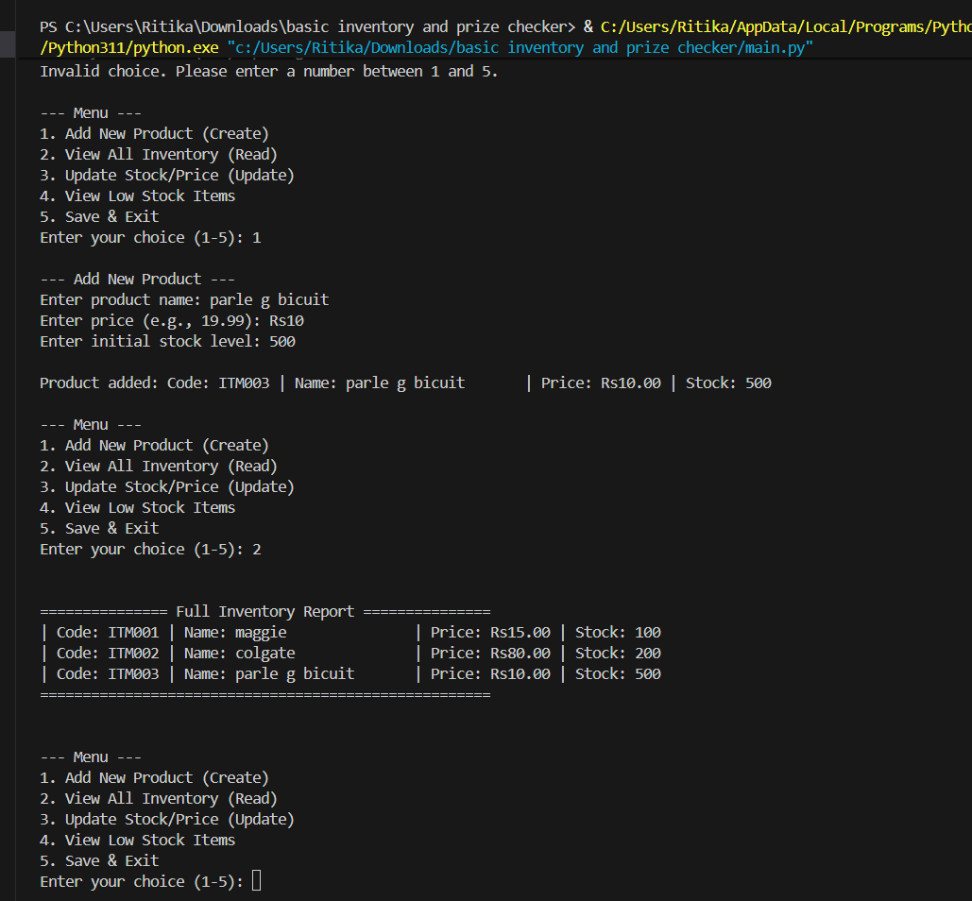
Chapter 9
Screenshots / Results

Slide 11
Chapter 10
Testing Approach
The system was tested using both:
Unit Testing: Individual functions (e.g., code generation, input validation) were tested to verify correct output and logic.
Integration Testing: Full feature cycles (Add, Save, Exit, Reload, Update) were tested to ensure end-to-end data persistence and system stability

Slide 12
Chapter 11
Challenges Faced
1) JSON Type Casting: The most significant challenge was maintaining data type integrity during persistence. When data was loaded from the JSON file, numerical fields like price (float) and stock (integer) were often read as strings, leading to logical errors in comparisons (e.g., checking for low stock).
  2)Resolution: Explicit type casting (int() and float()) was enforced dur- ing the deserialization (loading) process in the load_data() method.
Input Validation Loops: Implementing user-friendly input validation (NFR1) required robust while loops and nested try-except blocks to catch errors and prompt the user to re-enter data without crashing the application. This required careful design to maintain (Usability).

Slide 13
Chapter 12
Learnings & Key Takeaways
OOP Value: The use of classes (Product, InventoryManager) proved invalu- able in separating data from logic, making the code highly maintainable and easy to debug.
Persistence Detail: Managing persistence in a database-less system high- lights the critical importance of serialization/deserialization processes, par- ticularly concerning data type consistency.
Defensive Programming: The project reinforced the need for defensive pro- gramming—always anticipating and validating user input, as this is the most common point of failure in interactive applications.

Slide 14
Chapter 13
Future Enhancements
The following enhancements are recommended for Phase II development:
Transaction Logging: Implement a separate module to log all stock move- ments (stock added/removed) with timestamps for detailed auditing.
Database Integration: Migrate from JSON to a lightweight SQL database (e.g., SQLite) to handle concurrent access and improve query efficiency.
Barcode/SKU Support: Integrate support for scanning or entering standard SKU or barcode formats, not just the internal Item ID.
Reporting Module: Introduce advanced reports, such as inventory valuation (Price x Stock) and a list of items not sold in the last 30 days.

Slide 15
Chapter 14
References
Python 3.10 Official Documentation. (Retrieved October 2025).
Gamma, E., Helm, R., Johnson, R., & Vlissides, J. (1994). Design Patterns: Ele- ments of Reusable Object-Oriented Software. Addison-Wesley. (Referenced for OOP principles).
W3Schools. JSON Introduction and Usage. (Referenced for JSON syntax and structure).

